Slide 1
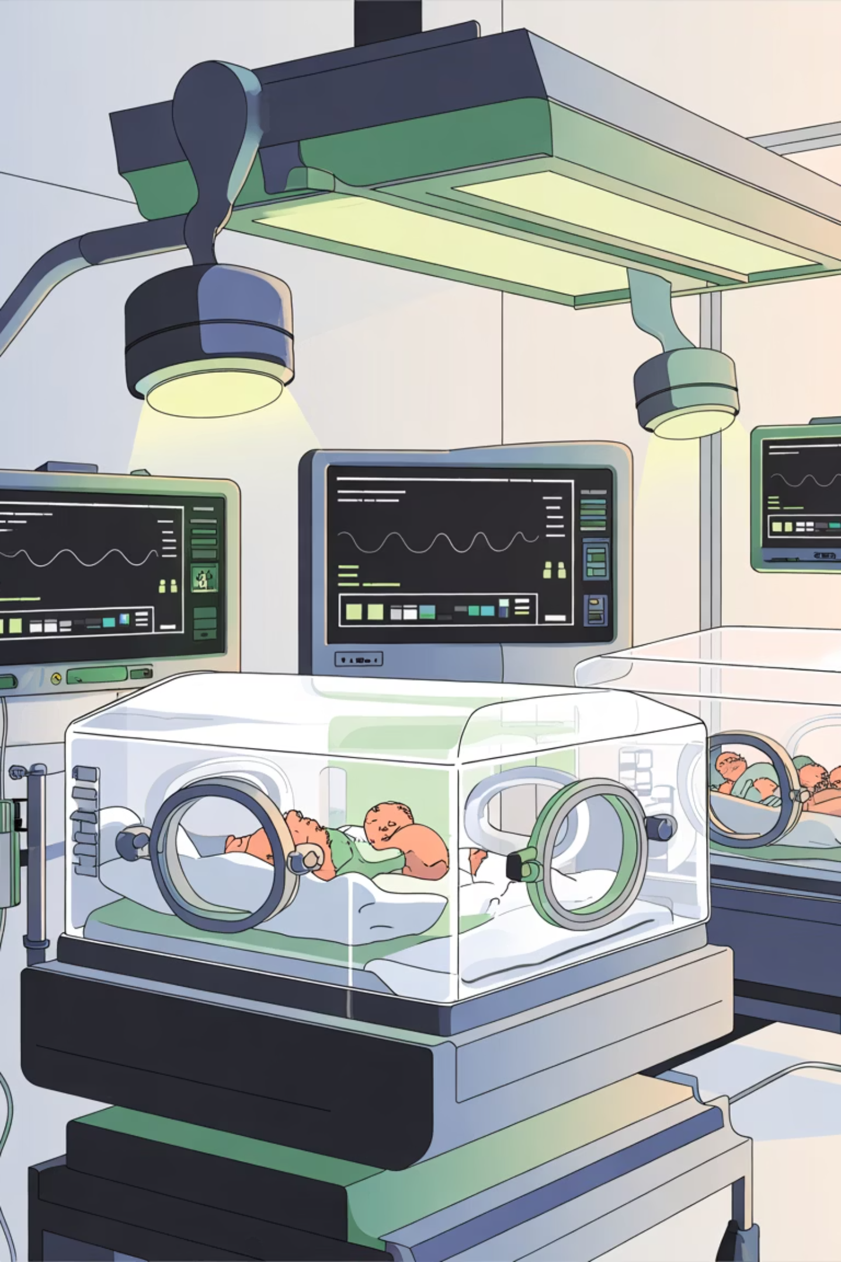

Smart Neonatal Phototherapy
Measure. Treat. Monitor.
IoT-enabled, noninvasive closed-loop therapy with real-time bilirubin monitoring and adaptive blue/blue-green LED dosing for neonatal jaundice.

Slide 2
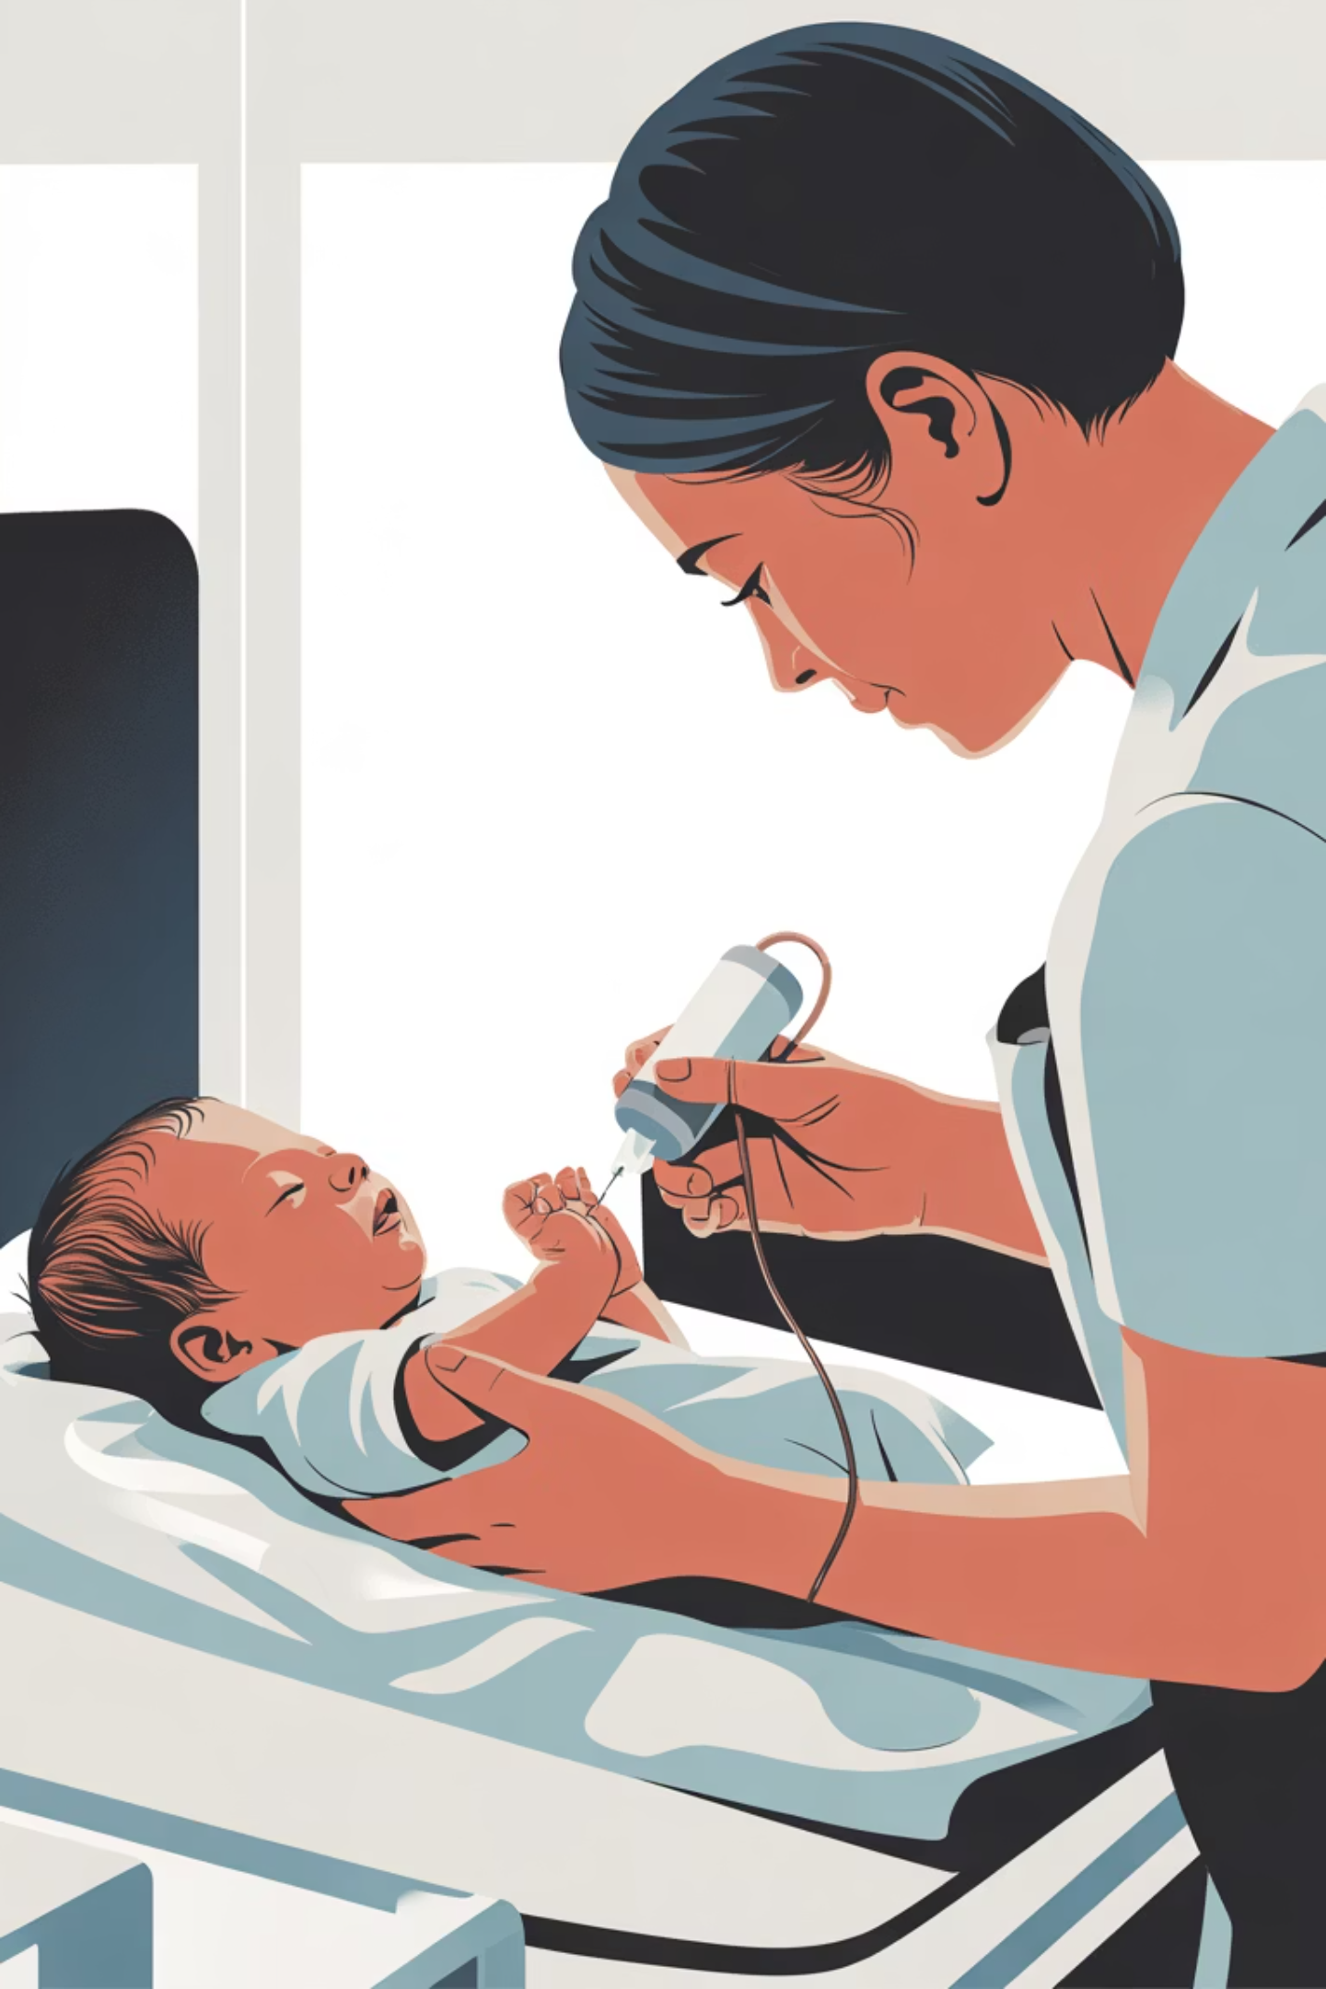
The Clinical Problem
Current phototherapy relies on open-loop delivery, painful serum draws, variable dosing, and limited real-time feedback—creating gaps in safety and efficacy.
Open-Loop Delivery
Fixed intensity without adjustment to individual patient response or bilirubin trends
Painful Blood Draws
Serum bilirubin requires invasive sampling every 6–24 hours; causes infant distress
Variable Dosing
Inconsistent irradiance delivery and lack of real-time verification across units
Limited Data
No continuous monitoring or dashboard insights for clinicians to optimize care

Slide 3
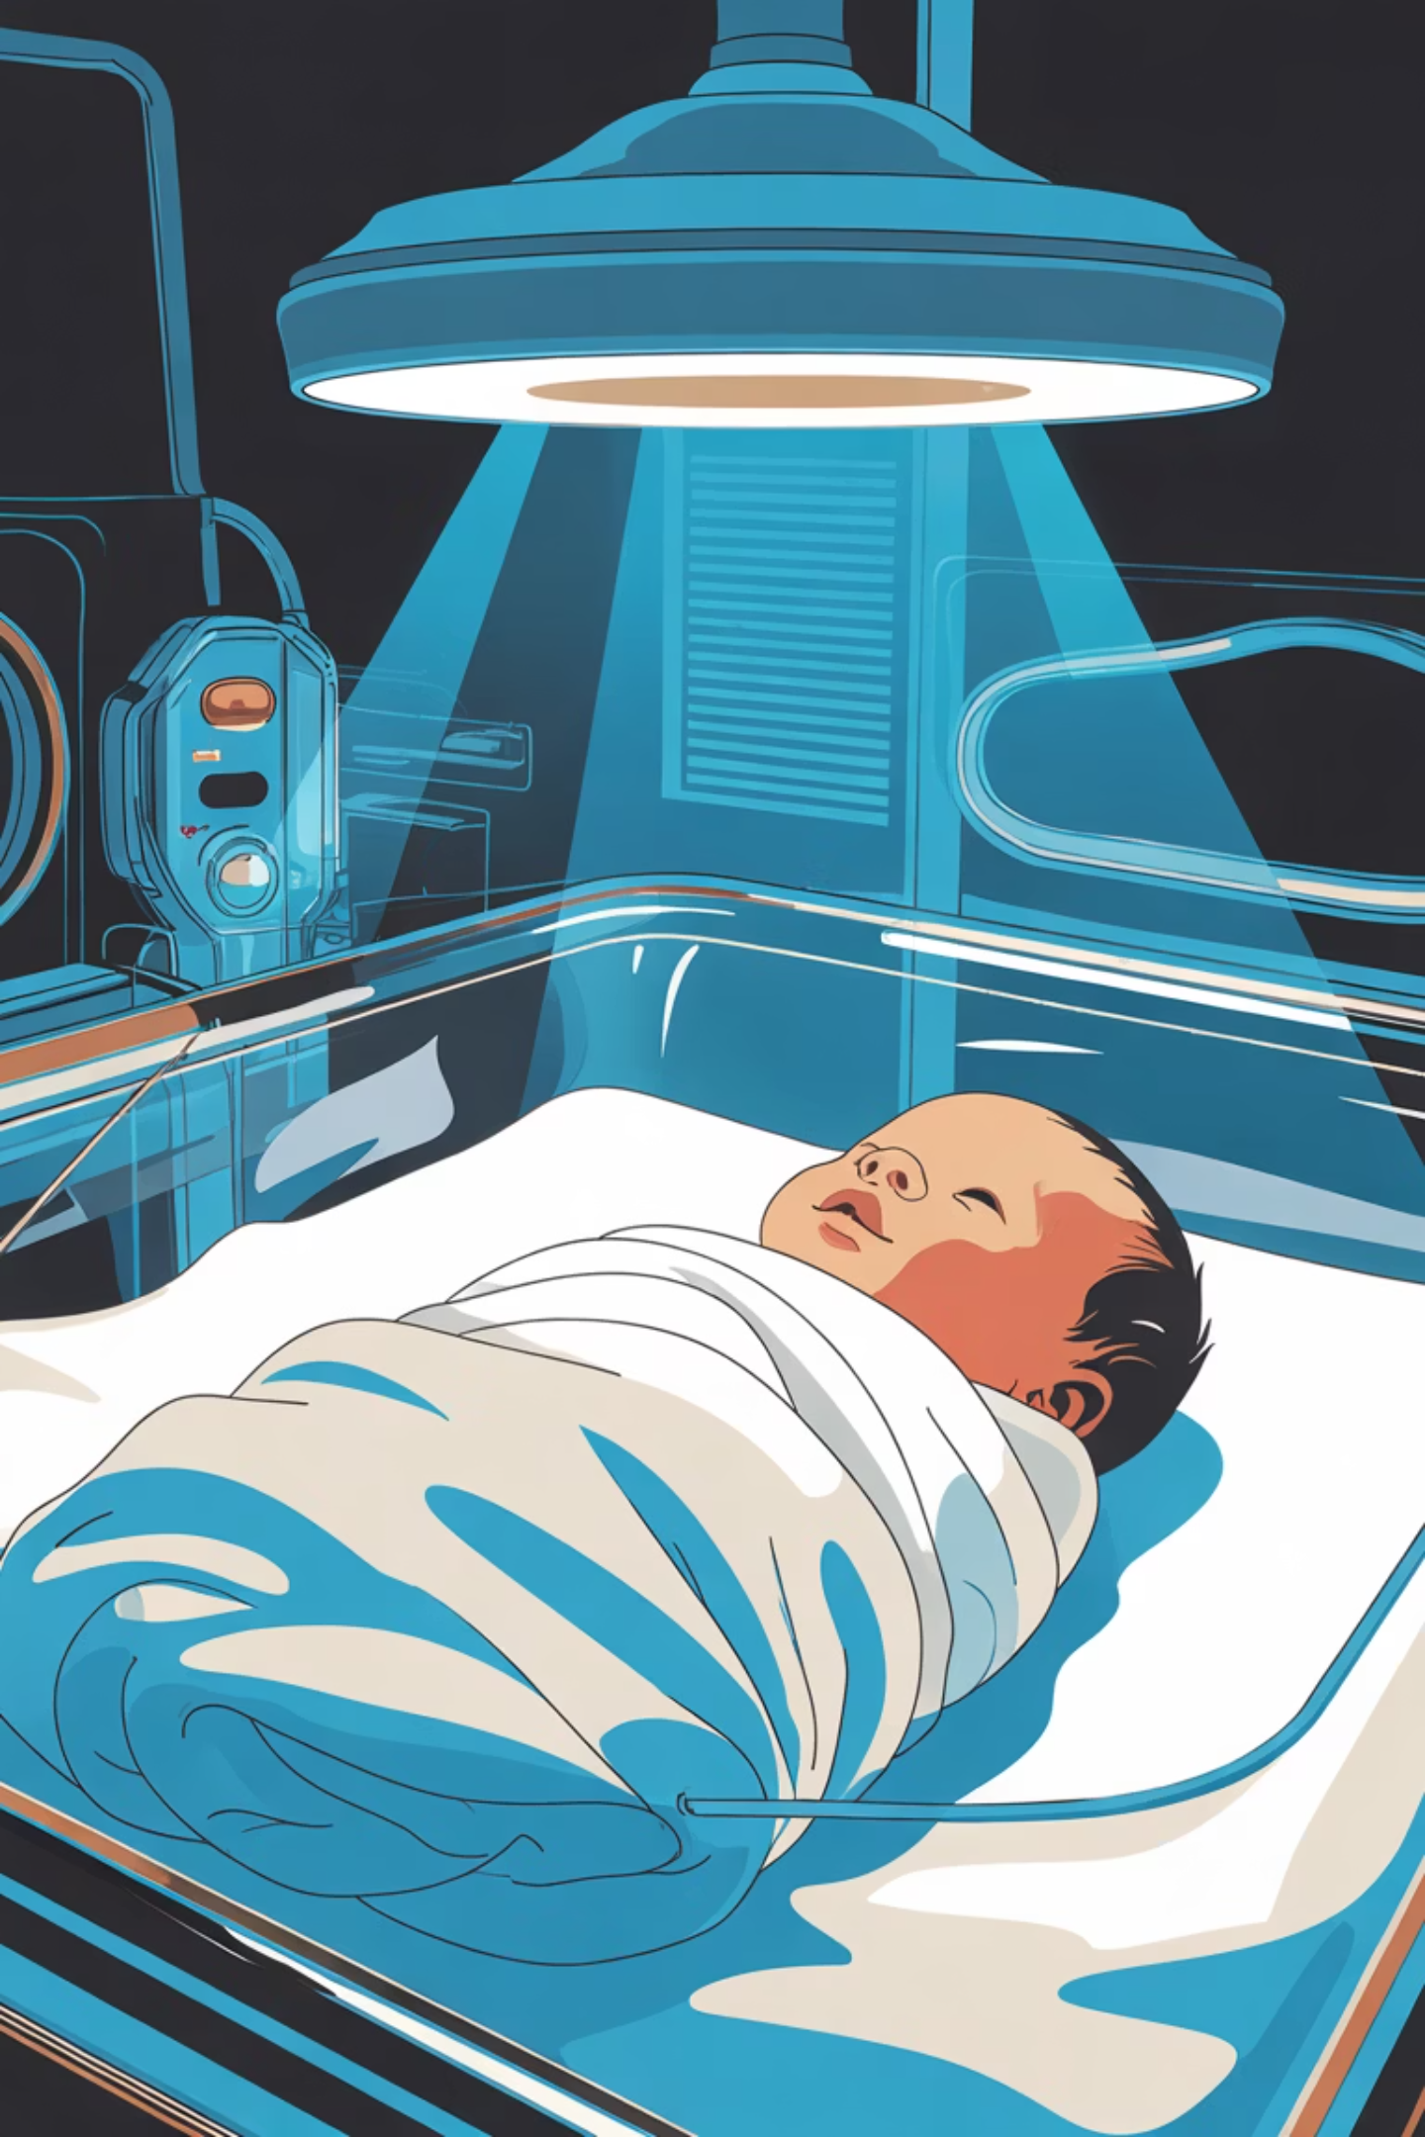
Prevalence & Risk Scope
Who Is Affected
Clinical Impact
~60% of term infants develop jaundice
Untreated severe hyperbilirubinemia can progress to acute bilirubin encephalopathy (ABE) and kernicterus—causing cerebral palsy, hearing loss, and developmental delay. Early detection and intensive phototherapy are critical to prevent permanent neurologic injury.
Higher rates in preterm due to immature bilirubin clearance
Hemolysis, bruising, G6PD deficiency increase risk
Early suboptimal feeding compounds risk

Slide 4
Bilirubin Pathophysiology & Neurologic Risk
Unconjugated bilirubin crosses the immature blood-brain barrier, binding to albumin and gray matter. High free bilirubin causes ABE (lethargy, hypotonia, poor feeding) and chronic kernicterus (hearing loss, oculomotor impairment, cerebral palsy). Rapid, intensive phototherapy within the first 24–48 hours is essential.
Mild Hyperbilirubinemia
1
Jaundice visible; TSB below phototherapy threshold
Severe Hyperbilirubinemia
2
TSB approaches or exceeds treatment threshold; risk of ABE increases
Acute Bilirubin Encephalopathy
3
Altered consciousness, hypotonia, fever; requires emergency intervention
Chronic Kernicterus
4
Permanent neurologic sequelae; hearing loss, cerebral palsy, oculomotor dysfunction

Slide 5
Our Solution: Smart Phototherapy Platform
2
1
3
Automated Treatment
Adaptive LED engine auto-adjusts light intensity based on real-time bilirubin data for optimal therapy
Noninvasive Measurement
Transcutaneous bilirubin sensing array continuously measures levels through skin without painful heel sticks
Continuous Monitoring
IoT dashboard streams critical data to clinicians and parents anywhere, anytime on any device

Slide 6
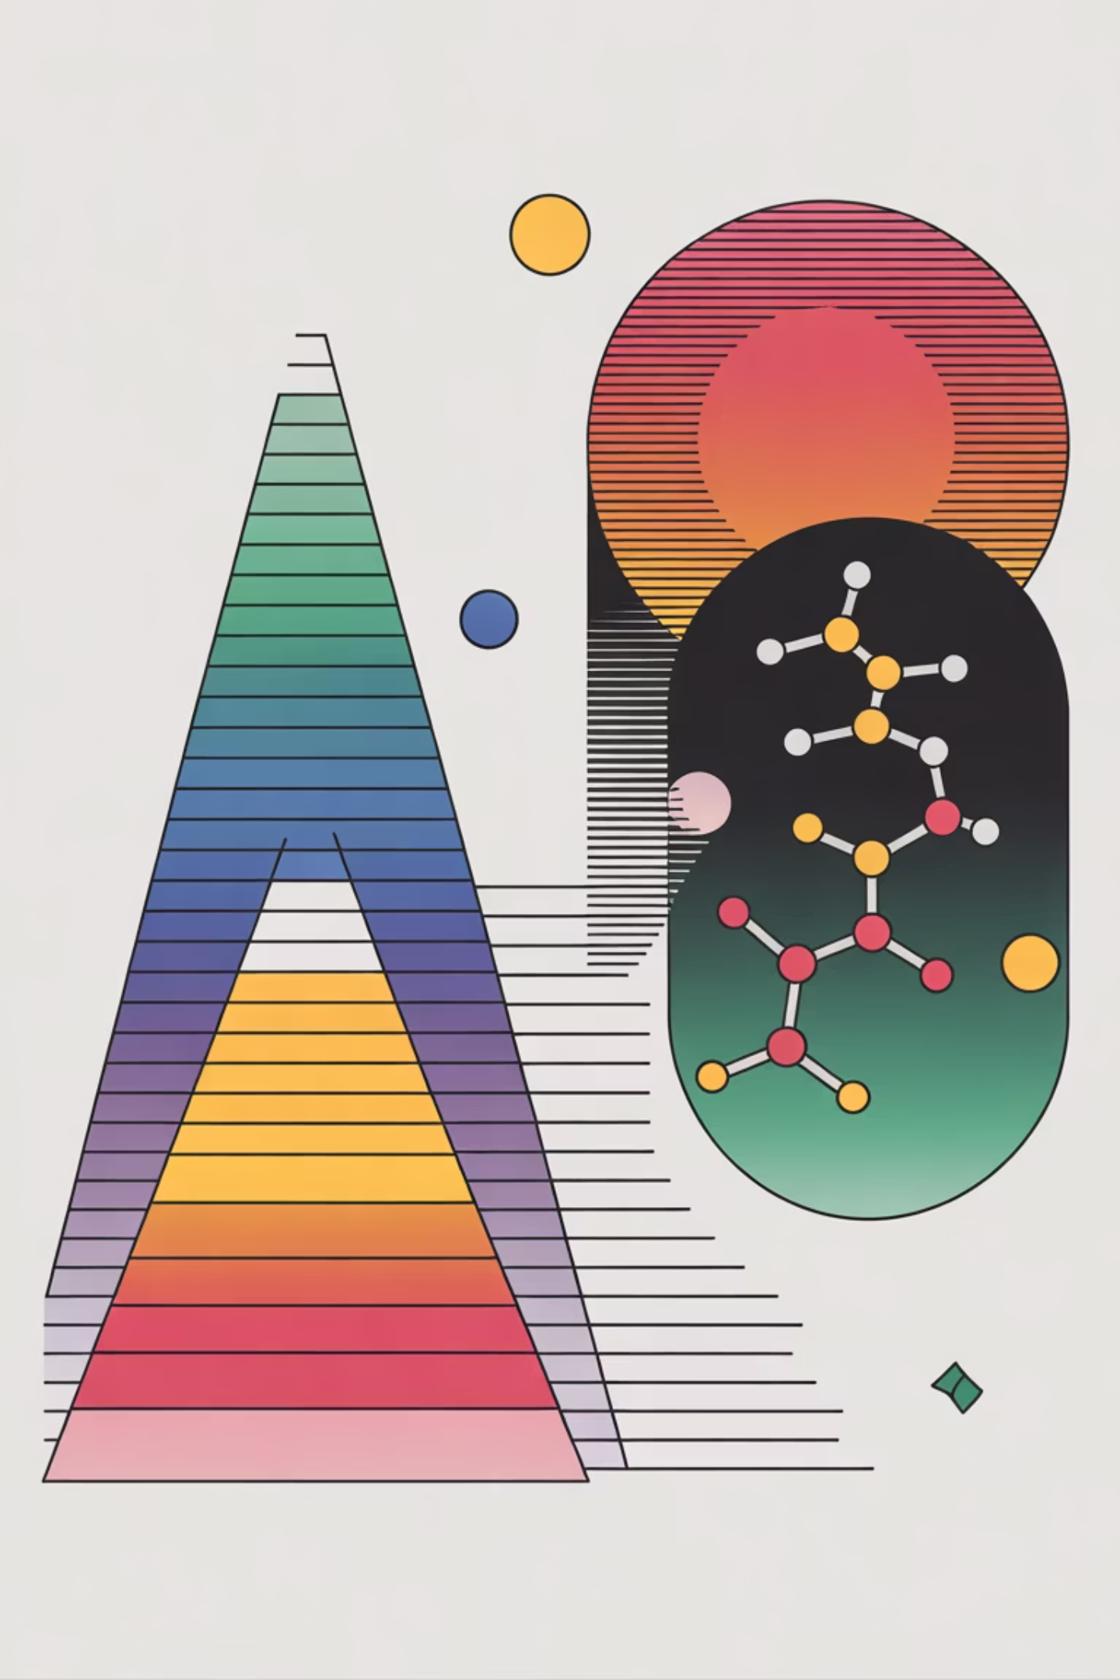
Light Spectrum & Bilirubin Chemistry
Bilirubin absorbs light most effectively within 460–490 nm (blue-green range). Phototherapy converts unconjugated bilirubin to water-soluble lumirubin and photoisomers via photooxidation—enabling rapid urinary and biliary excretion. Blue-green (478–480 nm) can match or exceed blue (460 nm) efficacy in vivo.
Peak Absorption
Lumirubin Formation
460–490 nm matches bilirubin's extinction coefficient; optimal skin penetration
Photoisomerization creates water-soluble metabolites; rapid renal clearance
Blue-Green Advantage
478–480 nm penetrates deeper; reduced phototherapy duration; comparable efficacy

Slide 7
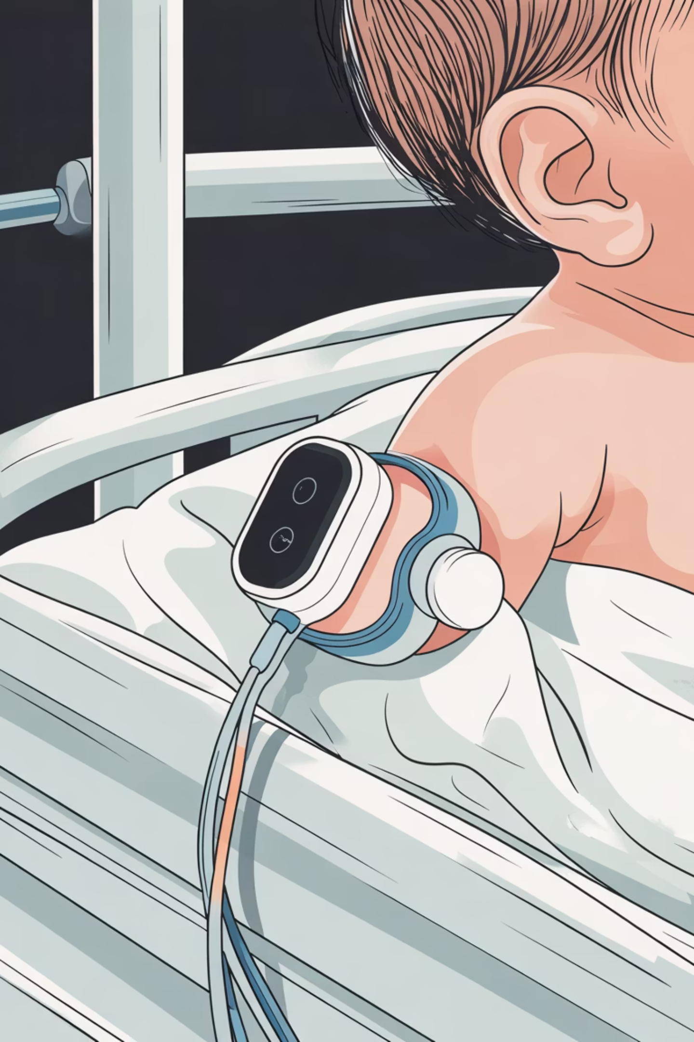

The Solution: Closed-Loop IoT Phototherapy
A wearable, noninvasive sensor continuously monitors transcutaneous bilirubin (TcB) via multiwavelength reflectance spectroscopy, triggering adaptive blue/blue-green LED dosing. Real-time skin temperature monitoring, safety interlocks, and cloud-based dashboard ensure efficacy and safety.
Noninvasive TcB Sensing
Multiwavelength reflectance with Hb/melanin compensation; no blood draws
Adaptive LED Dosing
460–490 nm intensity adjusts to TcB trend and safety thresholds in real-time
Thermal Safety
IR + contact temperature monitoring; automatic dose reduction if overheating
Cloud Dashboard
Real-time trends, compliance logs, and alert escalation for clinical teams

Slide 8
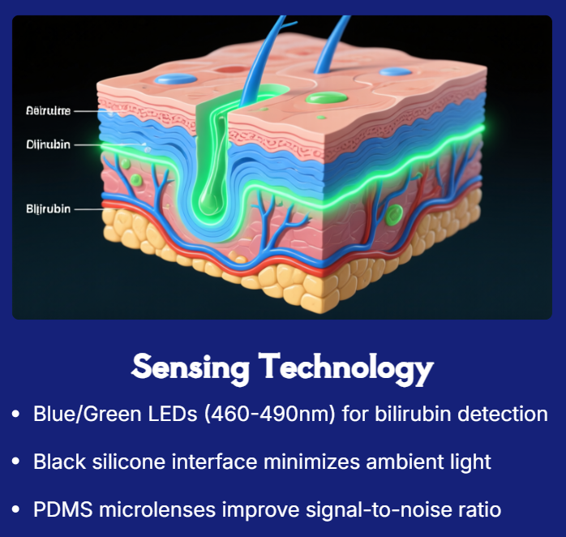
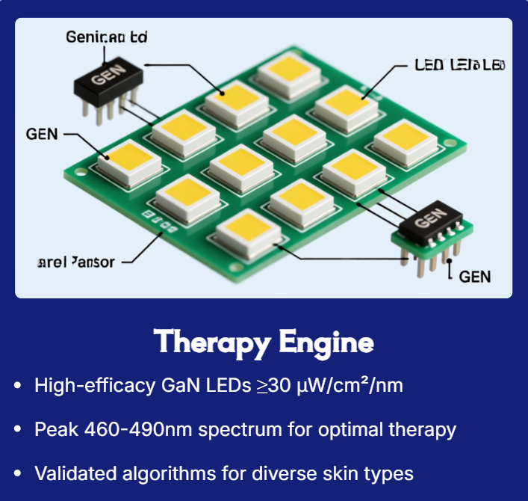
Core Technology: Advanced Optical Sensing

Slide 9
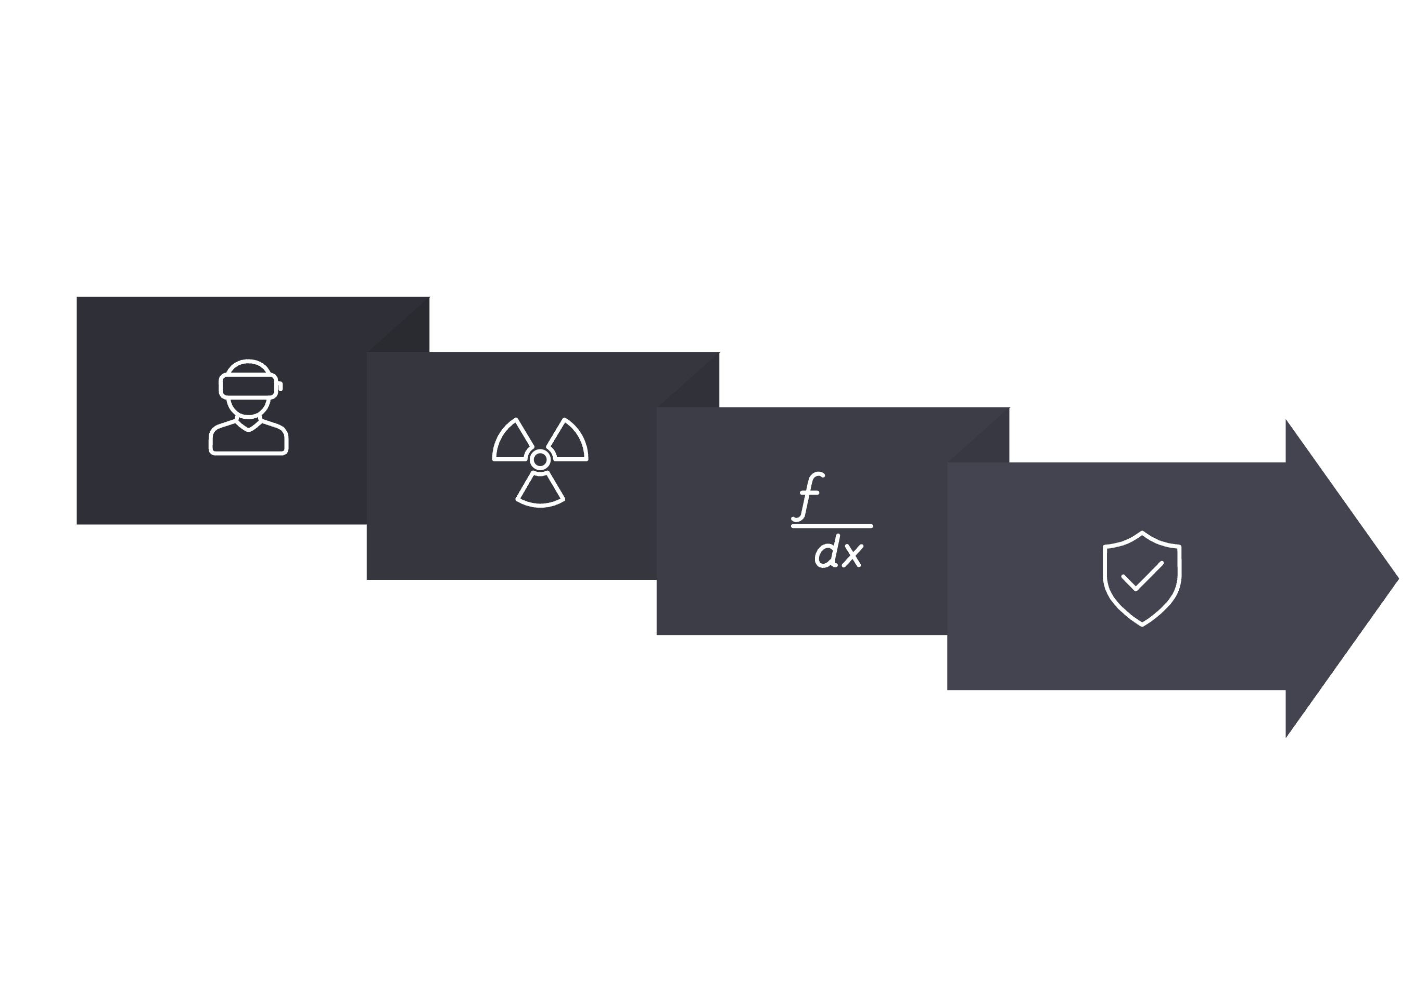
Closed-Loop Device Architecture
The system continuously cycles through multiwavelength LED emission and reflectance sensing, computing TcB and verifying safety before adjusting phototherapy intensity. All data are encrypted, transmitted to the cloud, and logged for clinical review and regulatory compliance.
Emit & Measure
Safety & Act
Attach Pad
Compute TcB

Slide 10
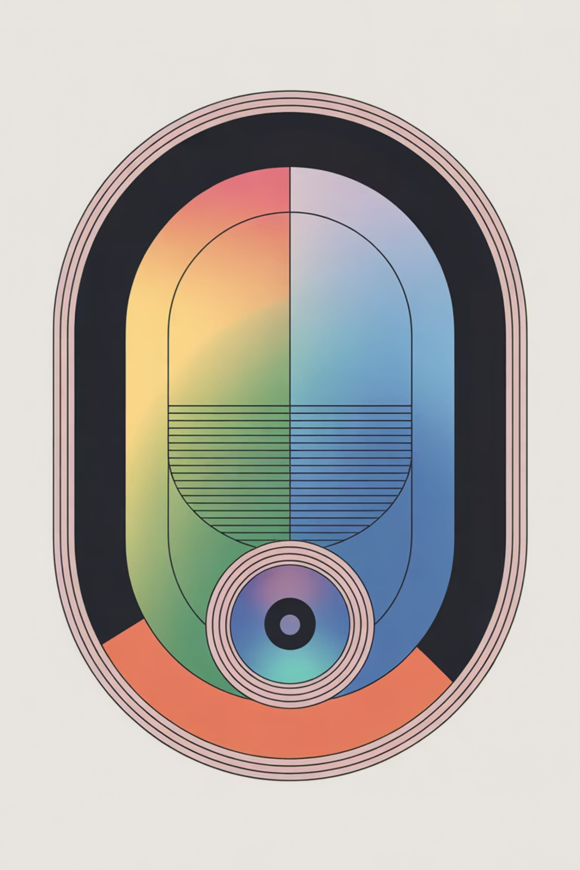
Sensor Design & Optics
Inspired by established pulse oximetry, the wearable sensor combines a low-noise analog front-end, multiwavelength LEDs (460, 480, 590 nm), and a Si PIN photodiode. Ambient light rejection, PDMS microlens optics, and black silicone interface ensure high signal-to-noise ratio and comfortable, secure fit.
Optical Path
Electronics
Multiwavelength LED array (blue, blue-green, green reference)
Current-controlled LED drivers for stable spectral output
Low-noise transimpedance amplifier (TIA)
PDMS microlens for collimated illumination
16–24-bit ADC for high resolution
Skin reflectance measured by Si PIN photodiode
MCU with BLE/Wi-Fi for real-time data transfer
Black silicone baffle rejects ambient light

Slide 11
Algorithms & Clinical Validation
TcB is computed using multiwavelength reflectance spectroscopy (BiliCheck-style), with Monte Carlo-aided regression to compensate for skin pigmentation and hemoglobin interference. Sequential inverse algorithms and optional machine learning regressors refine accuracy across diverse patient populations.
Algorithm
Core Principle
Clinical Benefit
Multiwavelength Reflectance
Measures skin reflectance at 460, 480, 590 nm; absorptions isolate bilirubin
Validated against serum TSB in term and preterm infants
Hb/Melanin Compensation
Monte Carlo radiative transfer models correct for hemoglobin and melanin absorption
Improves accuracy across diverse skin tones and anemia states
Sequential Inverse
Iterative calibration against reference TSB; adapts to individual variability
Reduces bias drift; extends accuracy over multi-hour therapy sessions
Optional ML Regressors
Neural networks trained on multicenter cohorts; learns nonlinear TcB–TSB mapping
Potential to surpass classical models; enables personalized compensation

Slide 12
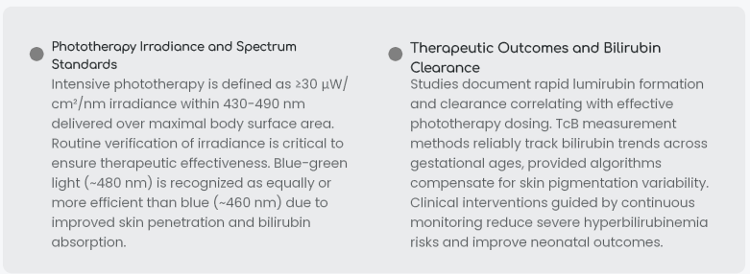


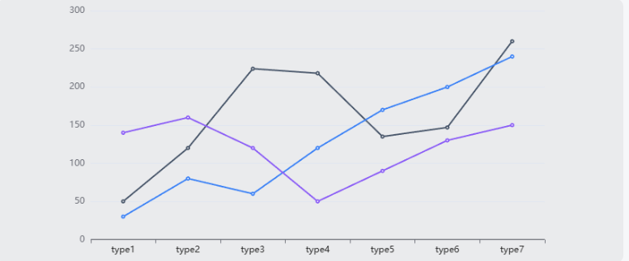

Clinical Validation & Phototherapy Standards

Slide 13
Clinical Evidence, Market Opportunity & Call to Action
Guidelines & Evidence
Value Proposition
Intensive phototherapy: ≥30 µW/cm²/nm in 430–490 nm spectral band
Eliminate painful blood draws. Continuous, noninvasive TcB monitoring reduces infant stress and clinician burden. Optimize phototherapy intensity. Real-time closed-loop dosing ensures guideline-compliant irradiance. Improve outcomes. Faster jaundice resolution, lower re-admission rates, and earlier discharge.
TcB validation: Noninvasive reflectance devices clinically validated; covered-site methods preserve accuracy
Market growth: Global births ~140M/year; phototherapy equipment market expanding with LED and connected-care adoption
Next Steps: We seek pilot partnerships with tertiary NICU centers and regulatory advisors to validate TcB accuracy, confirm user workflows, and align on FDA 510(k) pathway. Interested clinicians and evaluators—let's discuss feasibility and collaboration.
Regulatory pathway: Class II/III device; substantial equivalence to cleared photometers + sensors

Slide 14
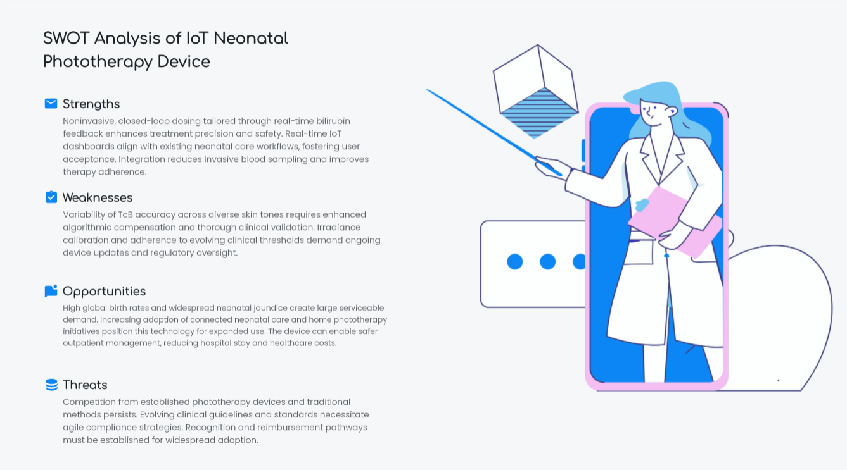

Slide 15
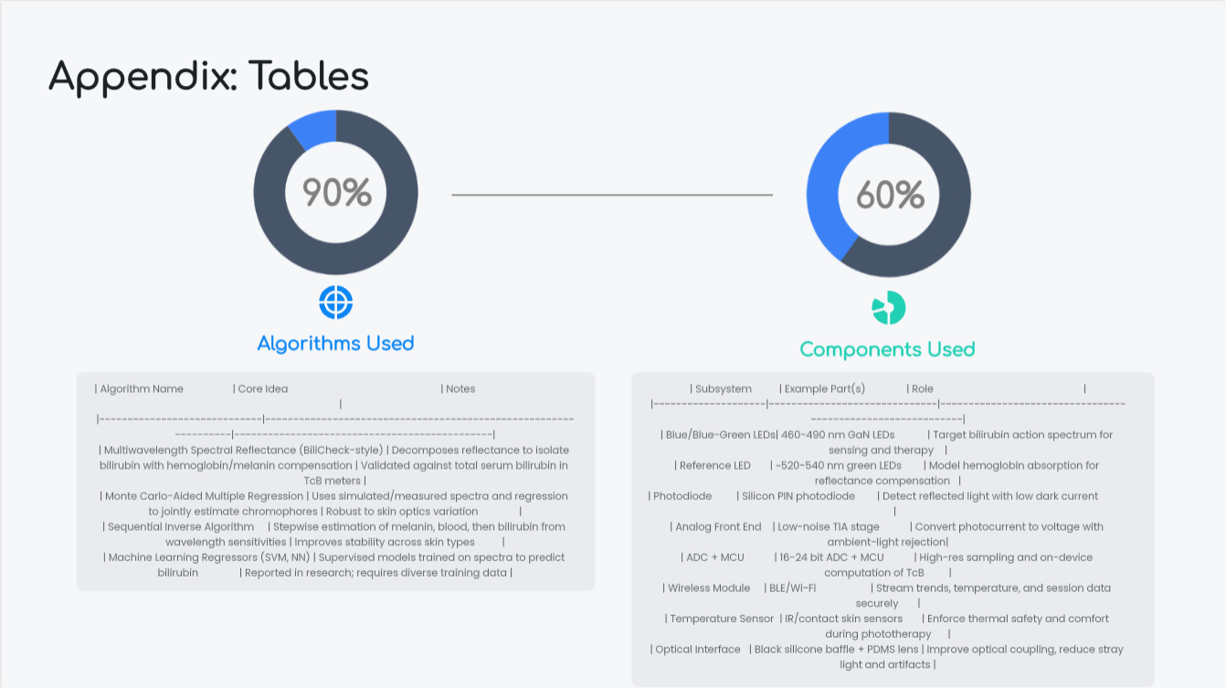

Slide 16
Questions???

Slide 17
THANK YOU….

